Slide 1
Where are we moving to? Because SF is just too expensive.
A deep dive into the US Census Data by Jello World

Slide 2
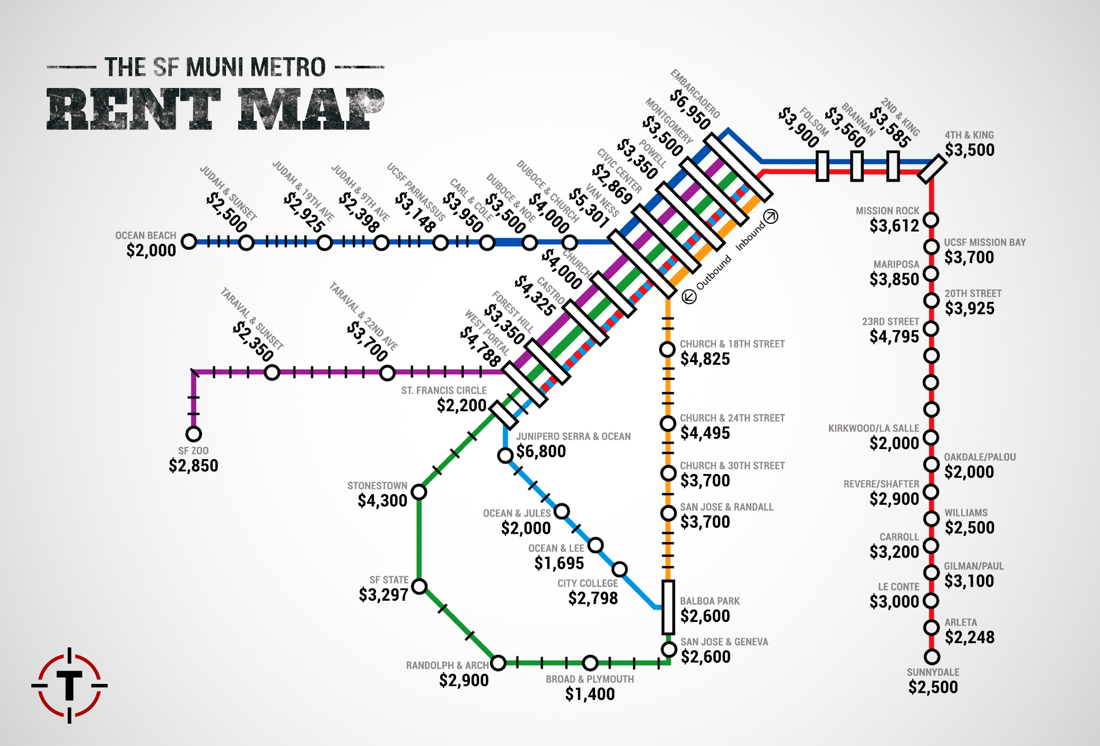
2015 Average 1 Bedroom Rent from Thrillest & Trulia

Slide 3
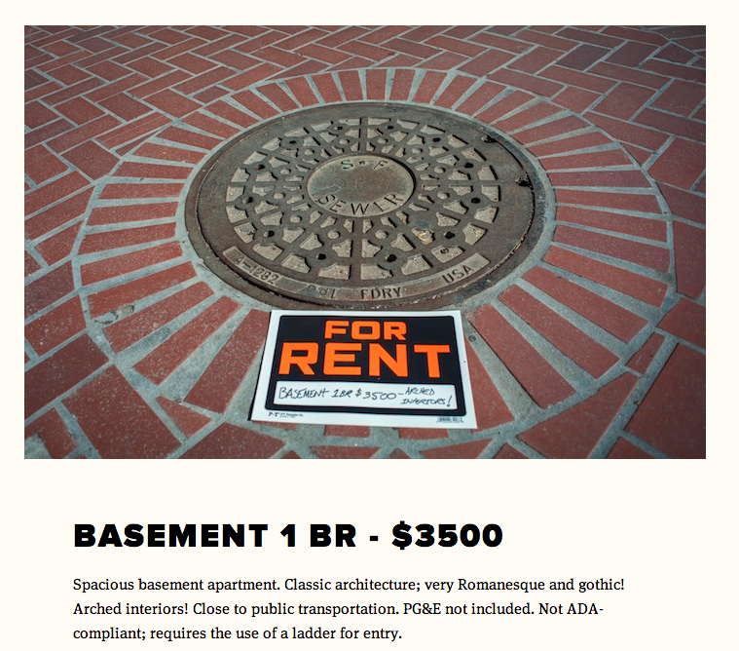
SF Be like…

Slide 4
Our thoughts during this process…
We gathered US Census data from 2011-2015
We decided on these years, as the economy was in a more stable state after the Great Recession and 2015 was the most recent year available in the API.
We initially wanted to compare data with Zillow API data, however we discovered that we needed an exact address to extract data.
Fortunately, the US census had some real estate data that we could leverage.
As a team, we had different techniques and philosophies.
Difficulties with Git
Solidifying dataframe from the start
Defining scope
Notes:
Summarize where and how you found the data you used to answer these questions
Describe the data exploration and cleanup process (accompanied by your Jupyter Notebook)
Describe the analysis process (accompanied by your Jupyter Notebook)

Slide 5
Jupyter Notebook

Slide 6
Describe the core message or hypothesis for your project.
Describe the questions you and your group found interesting, and what motivated you to answer them
Summarize where and how you found the data you used to answer these questions
Describe the data exploration and cleanup process (accompanied by your Jupyter Notebook)
Describe the analysis process (accompanied by your Jupyter Notebook)
Summarize your conclusions. This should include a numerical summary (i.e., what data did your analysis yield), as well as visualizations of that summary (plots of the final analysis data)
Discuss the implications of your findings. This is where you get to have an open-ended discussion about what your findings "mean".
Tell a good story! Storytelling through data analysis is no different than in literature. Find your narrative and use your analysis and visualization skills to highlight conflict and resolution in your data.

Slide 7
Chart/Analysis

Slide 8
Chart/Analysis

Slide 9
Chart/Analysis

Slide 10
Chart/Analysis

Slide 11
Chart/Analysis

Slide 12
Chart/Analysis

Slide 13
Conclusion

